Slide 1
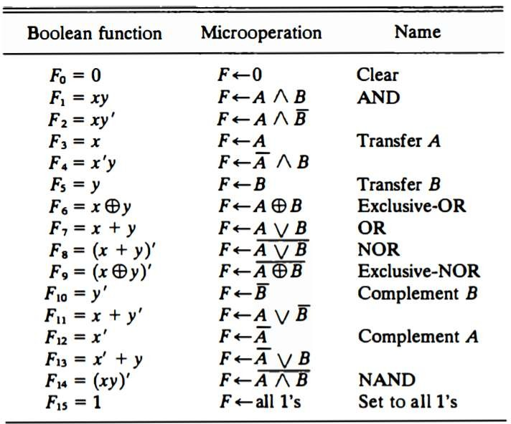
Computer System Architecture COMP201Th
Unit: 2
Basic Computer Organization and Design
Lecture: 6 Logical Micro-operations
Logic micro-operations specify binary operations for strings of bits stored in registers. These operations consider each bit of the register separately and treat them as binary variables e.g. the exclusive – OR micro operation with the contents of two registers R1 and R2 is symbolized by the statement:
P: R1← R1 ⊕ R2
It specifies a logic micro-operation to be executed on the individual bits of the registers provided that the control variable P=1.
e.g. let the content of R1 be 1010 and the content of R2 be 1100. The
exclusive-OR computation:
1010
1100
0110
micro-operation stated above symbolized the following logic
Content of R1
Content of R2
Content of R1 after P =1.
There are 16 different logic operations that can be performed with two binary variables.

Slide 2
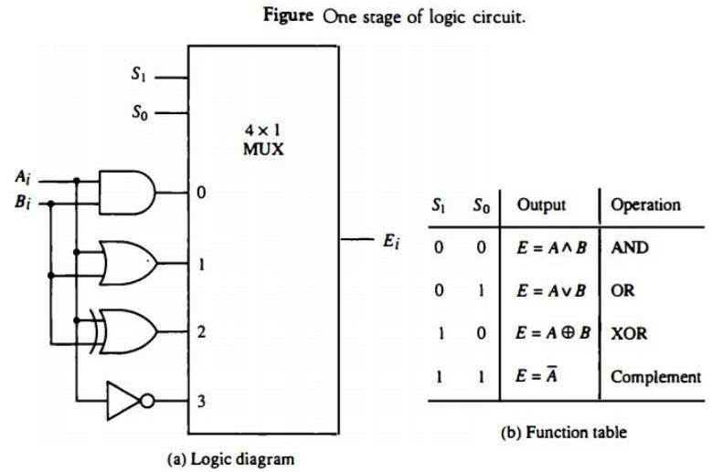
Hardware Implementation:
The hardware implementation of logic micro-operations requires that logic gates be inserted for each bit or pair of bits in the registers to perform the required logic function. Although, there are 16 logic micro-operations, most computers use only four- AND, OR, XOR (exclusive-OR) and complement ; from which all others can be derived.
Hardware Implementation:
Fig below shows one stage of a circuit that generates the four basic logic microoperations.
It consists of four gates and a multiplexer.
Each of the four logic operations is generated through a gate that performs the required logic.
The outputs of the gates are applied to the data inputs of the multiplexer.
The two selection inputs S1 and S0 choose one of the data inputs of the multiplexer and directs its value to the output.
The diagram shows one typical stage. For a logic circuit with n bits the diagram must be repeated n times.
Logic Diagram of Hardware Implementation of Logic Circuit

Slide 3
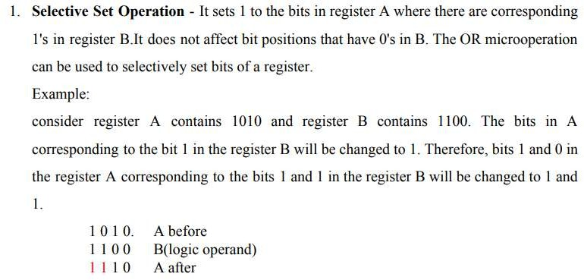
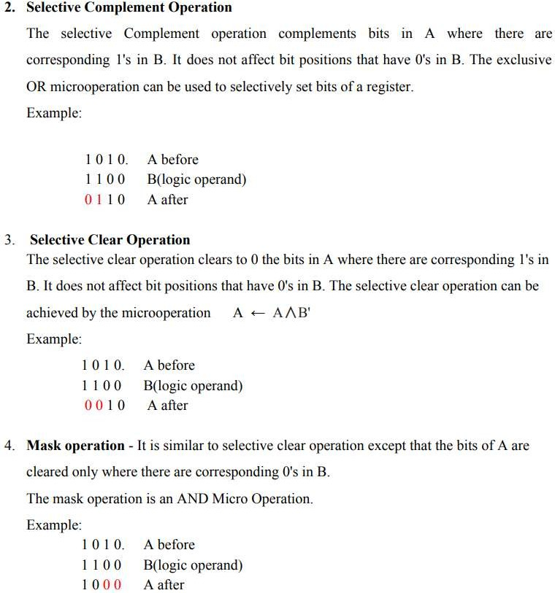
Applications of Logic Microoperations:

